Slide 1
DPS High School Options
Graduating Class of 2023

Slide 2
Options, Options, & More Options
Durham Public Schools offers many school options for students who are interested in applying to a school with a particular specialized program, non-traditional instructional method, or one that operates on a year-round calendar.

Slide 3
What’s a District School?
Riverside
Northern
Jordan
Hillside
Based on where you live/your address
Comprehensive with TONS of core classes, electives, honors/AP classes, sports, clubs, etc.
You can apply to a different district school through a transfer (in March) or their specialty pathways (now-Jan 31st)

Slide 4
What is a Pathway?
Pathways = specialized group of classes within a district school
Example: Riverside’s engineering program
Students must complete a minimum of one Pathway course per academic year to complete the Pathway Cluster requirement.

Slide 5
Hillside High School
Located in South Durham
3727 Fayetteville Road
1400 students

Slide 6
Hillside Pathways:
Business & Finance Academy
Students will choose ONE of the following Pathways:
1.Academy of Information & Technology
2. Academy of Finance
3. Business Management
*Transportation from base school
BFA
International Baccalaureate
The IB Programme gives each student a chance to earn college credits based on the scores earned on a series of assessments and exams taken during their senior year.
Students will graduate with a High School diploma and an IB Diploma
IB
JROTC
JROTC-Army
Encourages growth and excellence in leadership, character, academic achievement and physical fitness
Notes:
•IB: Designed to develop the intellectual, personal, emotional, & social skills to live, learn & work in a rapidly globalizing world. Scholarships are available specifically for IB students

Slide 7
Hillside High School
Hornet Academy (For All Entering Freshmen)
Transitional freshman program designed to create a smaller personal learning community
Help foster high academic achievement and high expectations for behavior
Hornet Academy also provides a comprehensive system of support for all freshmen to navigate high school successfully and graduate on time

Slide 8
Jordan High School
Located in South West Durham
6808 Garrett Road
1920 students

Slide 9
Jordan High School
Pathway Program: Agriculture, Food & Natural Resources Pathway
Learning the basics of food and animal sciences. Great for students interested in vetrinary medicine, agriculture, or food hospitality.
Each agricultural sciences pathway exposes students to classroom and laboratory experiences.
Required to take classes in: Agriscience Applications, Animal Sciences, Foods, Horticulture, and Vet Assisting
Transportation from base school

Slide 10
Riverside High School
Comprehensive high school within Durham Public Schools district
About 1740 students
Air Force JROTC Program
STEM Engineering and Technology Program

Slide 11
Riverside Pathways
JROTC-
Air Force
STEM:
Engineering & Technology

Slide 12
Riverside Cont’d
STEM: Engineering & Technology-
Must apply via the lottery whether in Riverside’s district or not (limited number of seats)
JROTC-Air Force:
The JROTC curriculum offers 4 different areas: Aerospace Science, Leadership Education, Physical Fitness, and Drilling

Slide 13
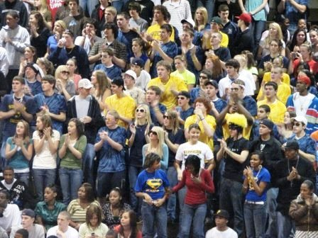
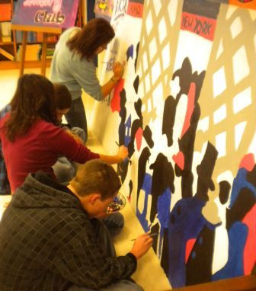
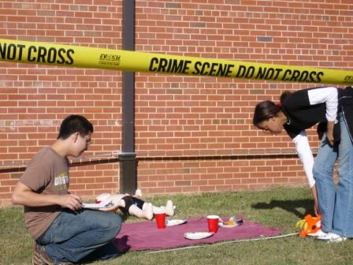
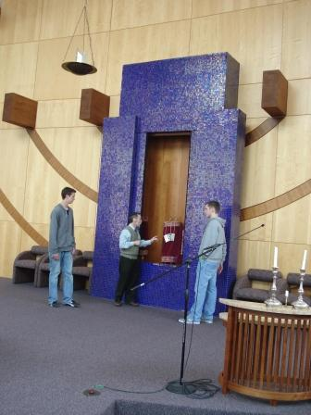
Northern High School

Slide 14
Northern Video

Slide 15
Northern Pathways
JROTC-
Air Force
Academy of Pre-Veterinary & Plant Science
Fire & Public Safety Academy
Pathway Programs
Culinary Chef Academy

Slide 16
Northern Pathways Chart
https://docs.google.com/document/d/1Z9ChfWJrWWHGnseLa3vybpAbXuMvrIjnGhGCvPX-BNQ/edit

Slide 17
Please note:
Students are not eligible to apply for a CTE Pathway Cluster at a high school that offers a similar Pathway Cluster at their base school.
Ex: Base school is Riverside you cannot apply to the JROTC at Hillside. If base school is Northern you cannot apply to Jordan’s
Ag, Foods, and Natural Resource Pathway

Slide 18
Magnet Schools
- Specialized schools in Durham Public Schools with a specific focus
- Must apply during the lottery period (Jan 7th – Jan 31st)

Slide 19
Magnet High Schools
City of Medicine Academy
Durham School of the Arts
Hillside New Tech
J.D. Clement Early College
School for Creative Studies
Southern School of Energy & Sustainability

Slide 20
School for Creative Studies
Video Production
Digital Music & Audio Production
Creative Entrepreneurship & Marketing
Architecture & Design for Living
Digital Media
1
2
3
4
5

Slide 21
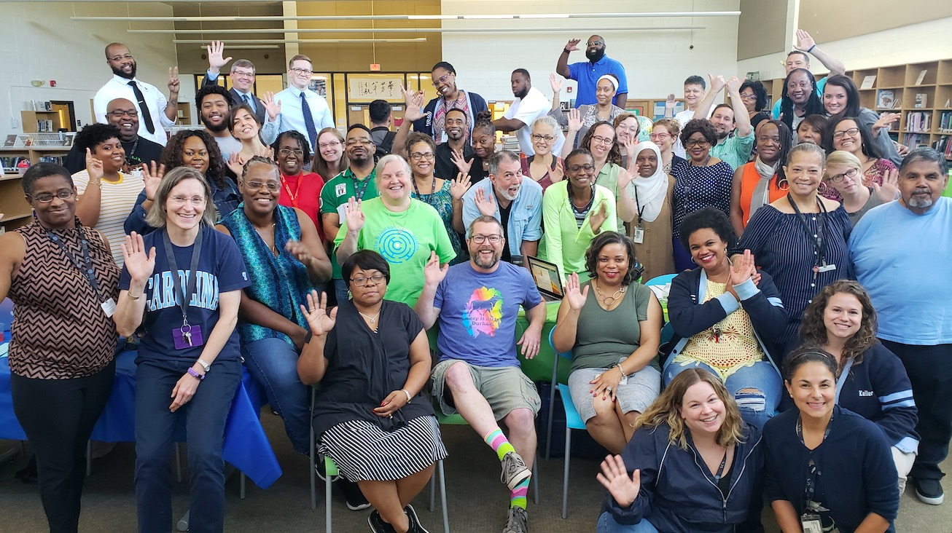
School for Creative Studies
Operates on a year-round calendar
Small School Environment: 100 students per grade
One-to-one macbook computers
Transportation provided for all of Durham County w/ Express bus stops
No NCHSAA Sports
But has cool physical clubs like fencing, ultimate frisbee, etc!

Slide 22
Southern School of Energy & Sustainability (SSES)
STEM focus
All students attending SSES will select from one of the four small schools
SSES offers a small school setting but also offers athletics, band and other extra curricular activities
Bus from base school to Southern
School of Business & Sustainability
Biomedical Technology
School of Computer & Technology Engineering
Architecture and Construction Engineering

Slide 23
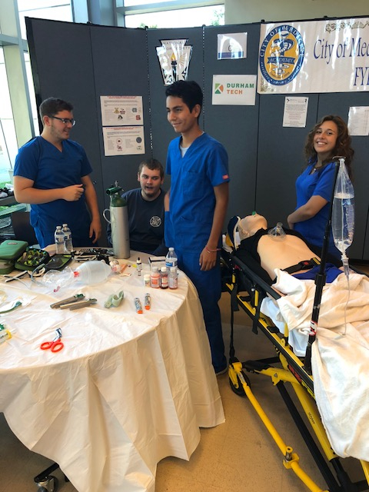
City of Medicine Academy (CMA)
•Aimed at future health care professionals; students are prepared for post-secondary health-care education or to enter the health care workforce
•All courses are Honors or AP level
•Possible certifications earned in high school can include: AED, EMT, Certified Nursing Assistant, Pharmacy Tech, & Surgical Tech
•Students job-shadow & conduct internships at local facilities & offices for experiential learning
•Dual enrollment opportunities with Durham Tech
•1:1 Technology for each student
•Paid summer Internships available
DRESS CODE OF SCRUBS
*Essay required in addition to online lottery process*

Slide 25
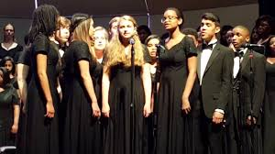
Durham School of the Arts (DSA)
•Emphasis on visual and performance arts
•Offers beginning through advanced arts courses in:
–band, chorus, piano, strings, guitar
–Visual Arts (art, sculpture, photography)
–dance, theater, creative writing
-digital arts (game art design, digital media)
•Still offers Honors and Advanced Placement courses in non-art subjects

Slide 26
DSA From Above

Slide 27
Hillside New Tech
•Challenging project-based learning approach with a STEM Focus
•Collaborative real-world investigations with fellow students & community partners
•All classes are Honors & AP
•Options to take classes at Durham Tech with books & transportation provided free
•Students can obtain certifications in Information Systems Security, Networking Technology, Electrical Systems Technology, & Computer Information Technology
•Small student to teacher ratio; 1:1 computer to students ratio
•Separate core classes & lunch, main Hillside for electives
•Required 150 hours of Community Service & a completion of a 50 hour Internship
- Must be in Hillside’s attendance zone to get transportation ☹

Slide 29
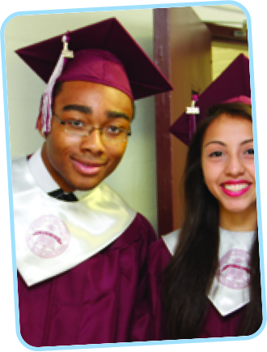
J.D. Clement Early College
•Located at North Carolina Central University, transportation anywhere in district
ALL classes are Honors or AP level classes
•Offers the opportunity to complete high school with up to 2 years of college credit towards a bachelor’s degree…FREE
•Rigorous curriculum with all courses offered at the Honors or AP level
•Junior year (11th grade) 75% of courses are at college level with NCCU students
•Senior year (12th grade) 75% of courses are at college level with NCCU students
**REQUIRES ONLINES APPLICATION AND A PAPER APPLICATION (essay/short answer, teacher recommendations, transcripts, report cards)

Slide 30
Early College

Slide 31
Annual Lottery Timeline for Magnet Schools and CTE Pathway Clusters - 2019
All applicants must have an e-mail address to create an online account and submit an application at www.dpsncapplication.com
The application process for JDC Early College Each applicant must submit the online application, and send/drop-off other required documents (references, transcripts, etc.) to the school.
Application for City of Medicine requires online application and online essay
Additional computer access:
o Durham Libraries – 8 locations across Durham
o Durham Housing Authority Community Centers – access for residents
o DPS Staff Development Center (SDC) – 2107 Hillandale Rd. (Monday-Friday 9 a.m.-3 p.m.)
o DPS Magnet Schools - 23 school sites
o Smart Phone Access - www.dpsncapplication.com
All lottery results will be posted Thursday, March 1st on the Smart Choice Dashboard of the parent’s online account.
Applicants selected must accept or decline their lottery seat on their Smart Choice Dashboard by Friday, March 22nd, 11:59 p.m. (no exceptions), and complete all registration requirements designated by the assigned school.

Slide 32
Annual Lottery Timeline
Monday, January 7, 2019, 12 a.m.
Through
Thursday, January 31, 2019 5:00 p.m.
Application Assistance Day - Staff Development Center –
2107 Hillandale Rd., Sat., January 19th, 9 a.m.-1 p.m.

Slide 33
Lottery Application Changes
Families may choose up to 3 schools on the online lottery application. You rank your choices. OR you can only choose 1, or 2 schools.
Lottery results will be posted on your Smartchoice Dashboard on March 1st and emailed, and/or texted. Once you have gotten a seat, or a spot on a waiting list, that is the end of the process. There will not be a second lottery. You have until march 22nd to accept or decline

Slide 34
Visit The Schools
All district, pathway programs, and magnet schools have school tours & school showcases during school or at night. Take a tour!!

Slide 35
Contact Information
Alex Soper
8th Grade Counselor
Carrington Middle School
919-560-3916 ext. 16224
alexander.soper@dpsnc.net

